Slide 1
Avolta
July-04-2024

Slide 2

Avolta

Slide 3
Avolta
Introduction to Avolta:
Avolta (formerly Dufry until November 2023)
Swiss-based travel retailer with a global presence
Operates duty-free and duty-paid shops and convenience stores
Store Locations:
Airports: Comprehensive retail offerings in major international airports
Seaports: Retail stores located at key seaports
Railway Stations: Convenient stores at railway stations
Company Facts:
Headquartered in Basel, Switzerland
Employs almost 36,000 people
Operations in over 65 countries worldwide

Slide 4
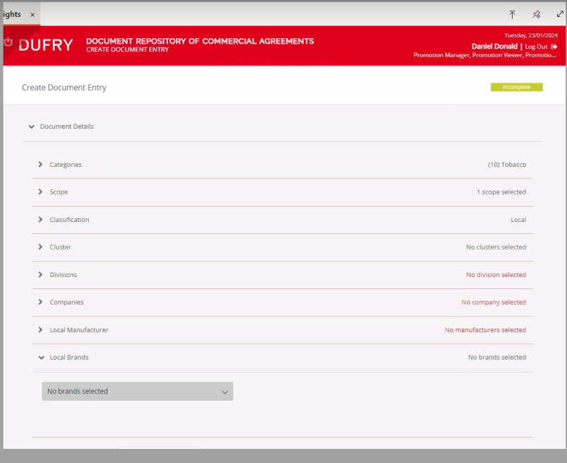
Identifying the Problem

Slide 5
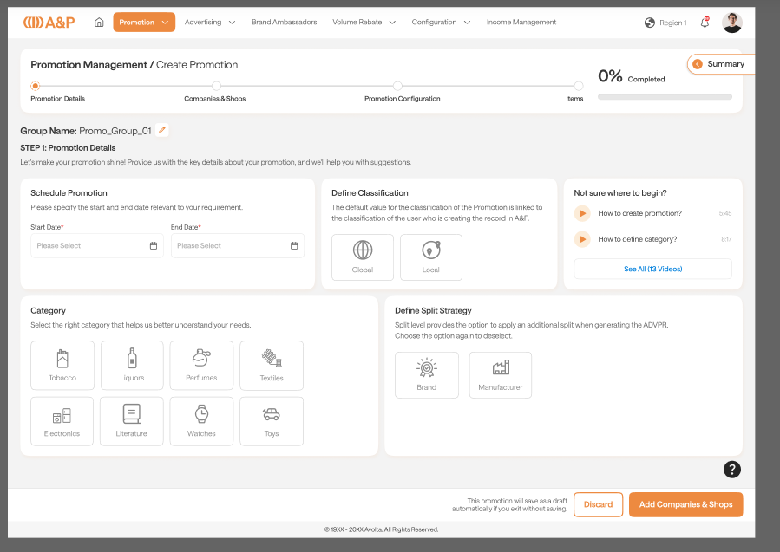
Proposed Solution

